Slide 1
Presentation Guidelines
Colors:
Pantone 287
Pantone 659
White
Pantone 143
Pantone 179
R 0
G 81
B 145
R 83
G 158
B 208
R 255
G 255
B 255
R 255
G 179
B 81
R 255
G 68
B 59
Black
Pantone 152
White
50% Black
R 0
G 0
B 0
R 245
G 120
B 20
R 255
G 255
B 255
R 150
G 150
B 150
Headlines: Arial Bold (80% black)
Fonts:
Sub Headlines: Arial Bold (Pantone 287 blue)
Body Copy: Arial (80% black)

Slide 2
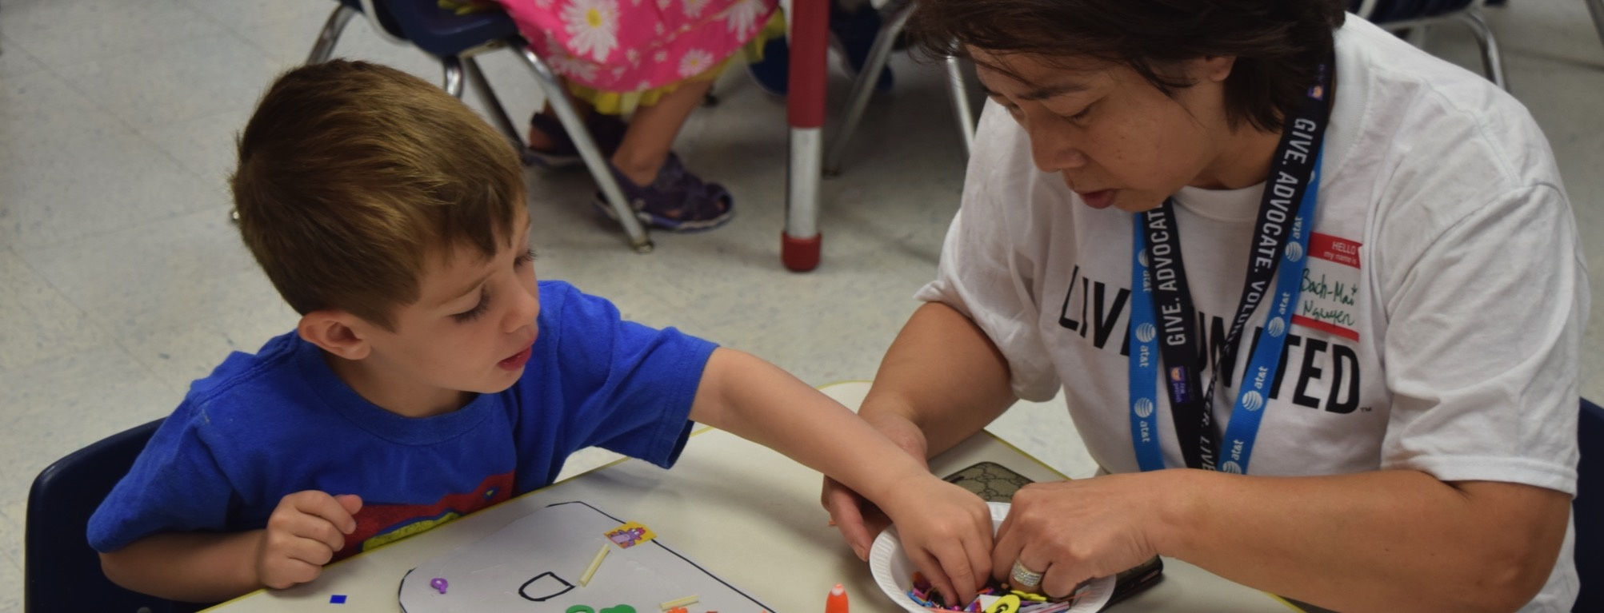

Title of Presentation
Date
Notes:
To ensure that the UNITED WE FIGHT. UNITED WE WIN. Artwork is on top of the photo you may have to click on photo box and select to SEND TO BACK.

Slide 3
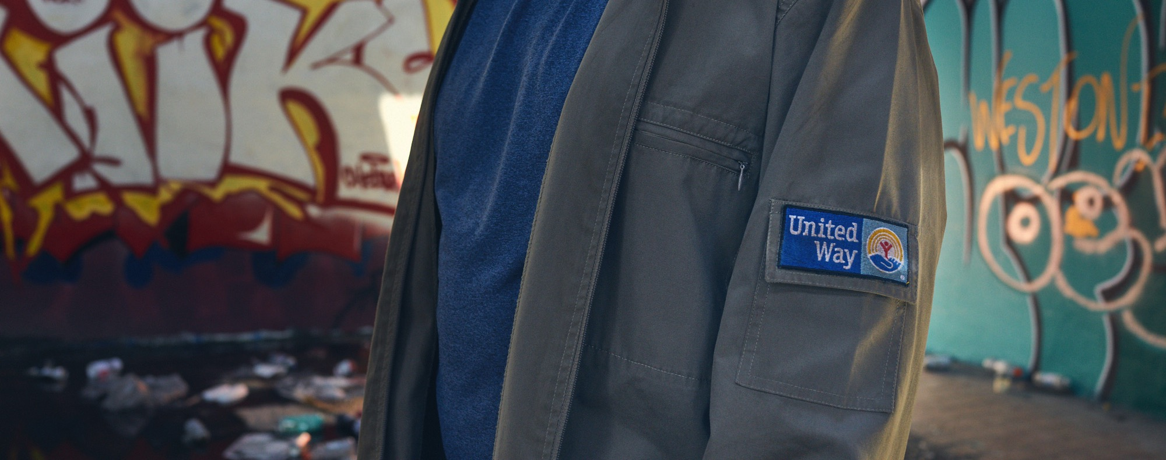
Title of Presentation
Date
Notes:
To ensure that the UNITED WE FIGHT. UNITED WE WIN. Artwork is on top of the photo you may have to click on photo box and select to SEND TO BACK.

Slide 4
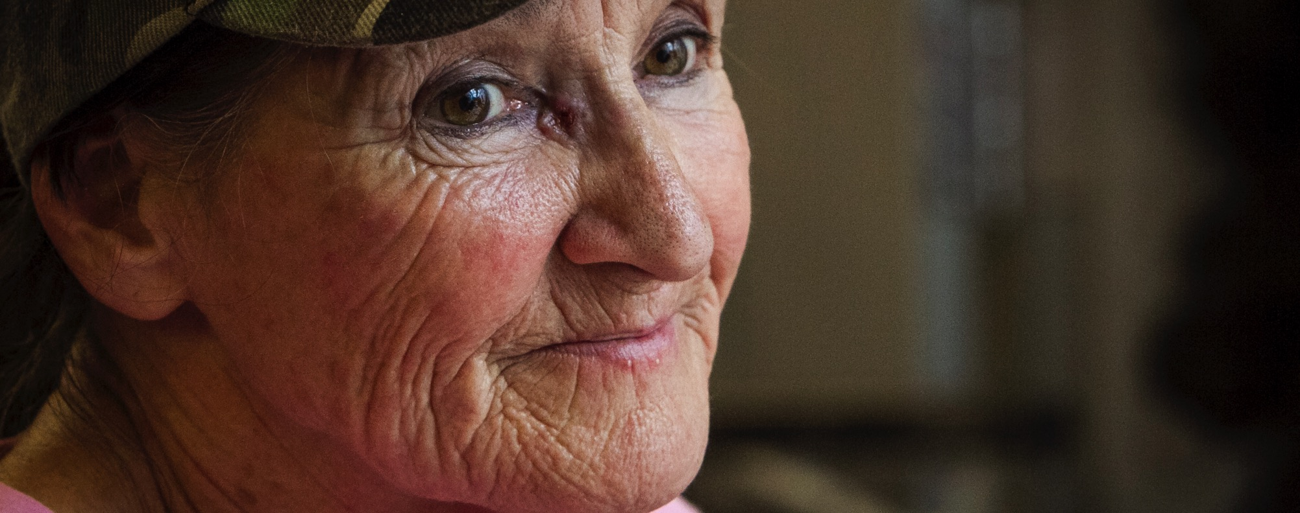
Title of Presentation
Date
Notes:
To ensure that the UNITED WE FIGHT. UNITED WE WIN. Artwork is on top of the photo you may have to click on photo box and select to SEND TO BACK.

Slide 5
Agenda
Who we are
What we do
Why relationship with Company X is important
Recap of Company X’s performance with United Way last year
Goals for this year
Next steps/action items
Close

Slide 7
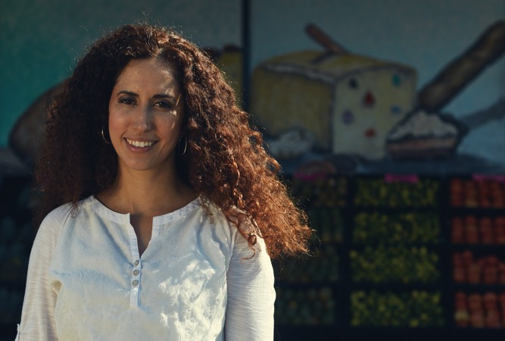
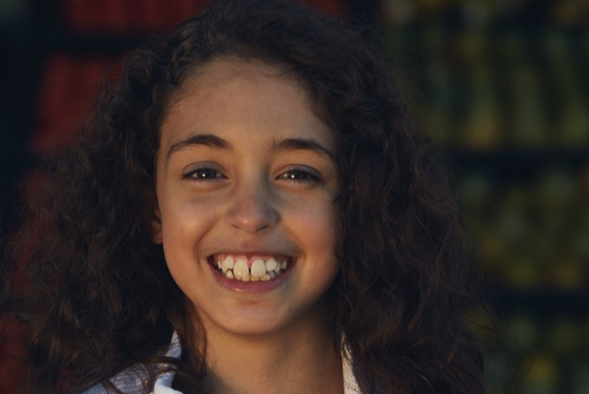
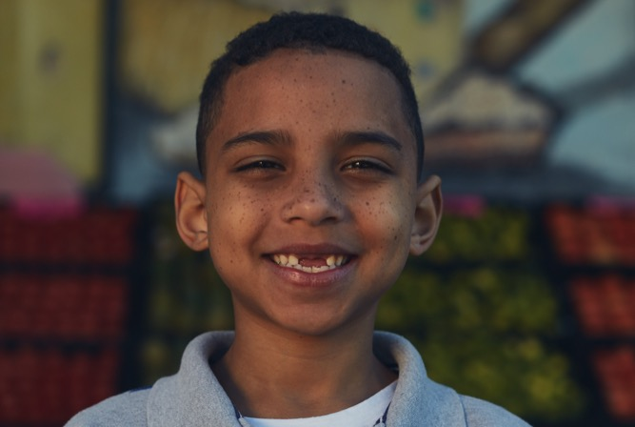
“Give. Advocate.Volunteer.”
Notes:
To ensure that the UNITED WE FIGHT. UNITED WE WIN. Artwork is on top of the photo you may have to click on photo box and select to SEND TO BACK.

Slide 8
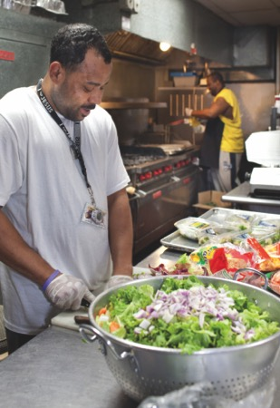
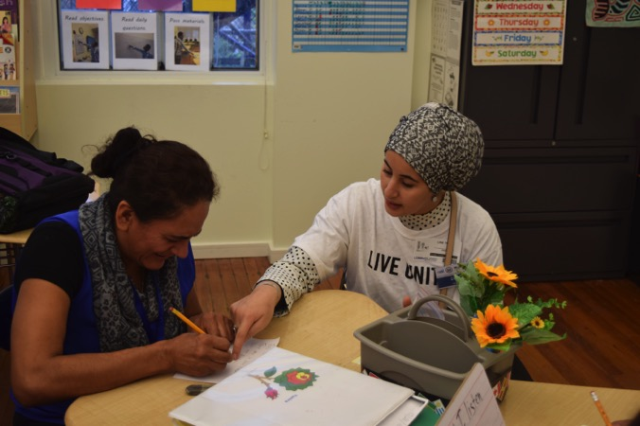
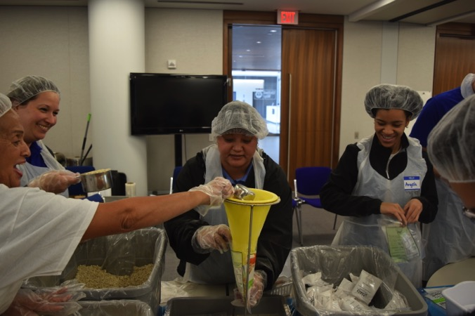
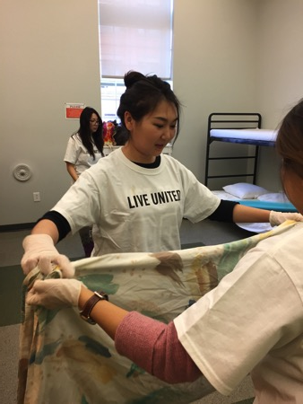
“Give. Advocate.Volunteer.”
Notes:
To ensure that the UNITED WE FIGHT. UNITED WE WIN. Artwork is on top of the photo you may have to click on photo box and select to SEND TO BACK.

Slide 9
Goals for this year

Slide 10
Chart example

Slide 11
Who we are.
Subtitle

Slide 12
What we do.
Subtitle

Slide 13
Goals for this year.
Subtitle

Slide 14
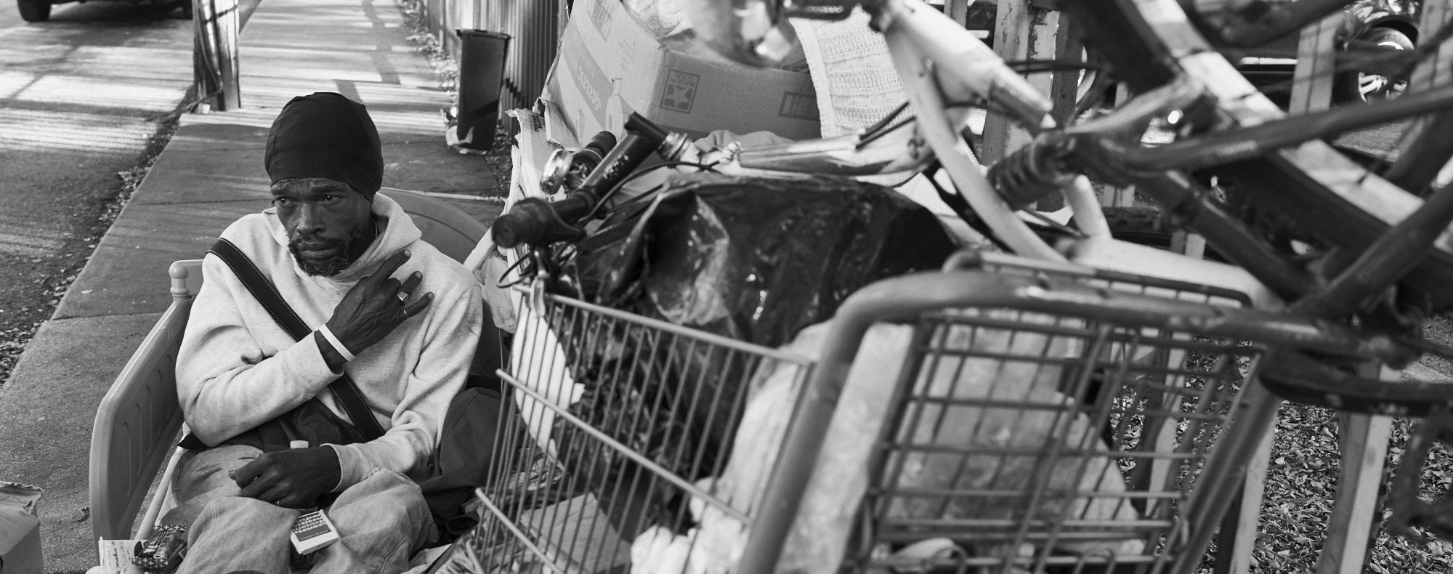
Title of presentation
Date
Notes:
To ensure that the UNITED WE FIGHT. UNITED WE WIN. Artwork is on top of the photo you may have to click on photo box and select to SEND TO BACK.

Slide 15
Agenda
Who we are
What we do
Why relationship with Company X is important
Recap of Company X’s performance with United Way last year
Goals for this year
Next steps/action items
Close

Slide 16
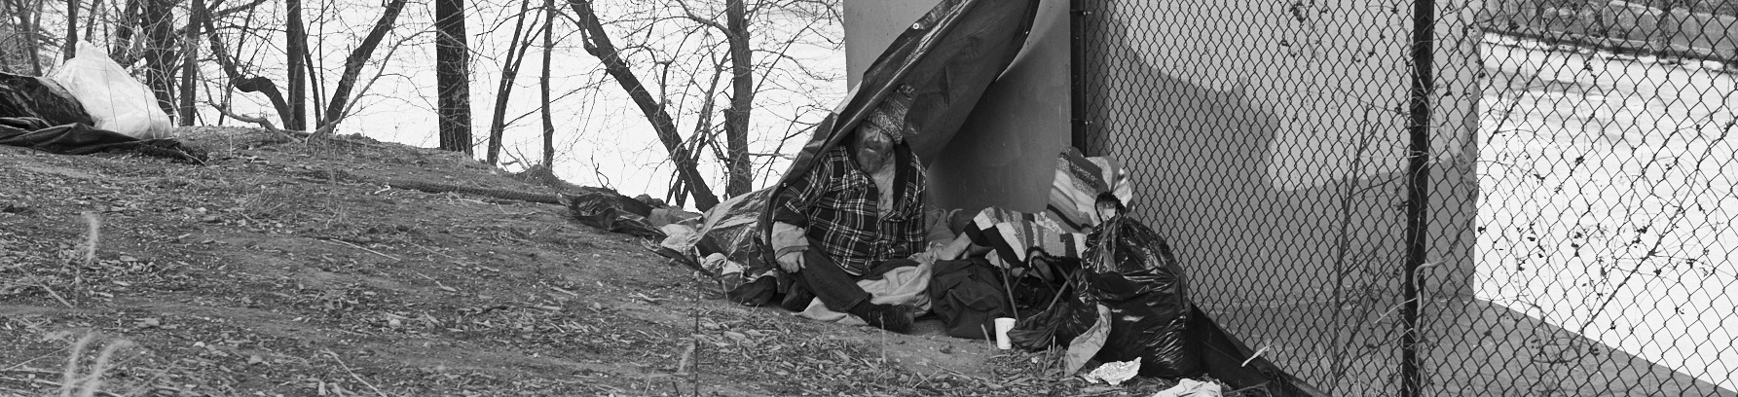
“Give. Advocate.Volunteer.”
Notes:
To ensure that the UNITED WE FIGHT. UNITED WE WIN. Artwork is on top of the photo you may have to click on photo box and select to SEND TO BACK.

Slide 17
Goals for this year

Slide 18
Volunteer

Slide 19
Chart example.

Slide 20
Thank you.

